Slide 1




Conspiracy Theories vs Critical Thinking Using an Ensemble of Transformers and Large Language Models
Angelo Maximilian Tulbure
Advisor: Prof. Mark James Carman
Co-advisors: Prof. Paolo Rosso, Mariona Coll Aldanuy (UPV)
11/12/2024

Slide 2

PAN 2024 Oppositional Thinking Analysis Tasks Description
TASKS DESCRIPTION
The challenge focuses on two primary tasks:
1. Binary Classification:
Determine whether a text is Conspiratorial or Critical
2. Span-Level Detection:
Detect elements of oppositional narratives in the texts
(AGENT, FACILITATOR, VICTIM, CAMPAIGNER, OBJECTIVE, NEGATIVE_EFFECT)
Datasets provided:
5.000 Telegram comments in English (4.000 for training and 1.000 for testing)
5.000 Telegram comments in Spanish (4.000 for training and 1.000 for testing)

Slide 3
Research Questions
TASKS DESCRIPTION
RQ1. How effectively can transformer models and Large Language Models distinguish between conspiracy theories and
critical thinking narratives, and which factors impact their performance?
Subquestions:
What are the main challenges in differentiating linguistic and rhetorical features between conspiratorial and critical
thinking narratives?
How do the performances of different models vary across languages?
RQ2. How feasible is it to accurately identify text spans that correspond to key elements within oppositional narratives?
Subquestions:
What are the primary difficulties in detecting partially overlapping narrative elements in multilingual datasets?
How does the context in which narrative elements appear influence their identification accuracy across different
models?
RQ3. To what extent do data augmentation techniques enhance model performance across the two tasks?
Subquestions:
Which data augmentation techniques contribute most significantly to improving model performance in binary
classification and span-level detection?
How does data augmentation impact the model’s ability to generalize across new or unseen narrative structures?

Slide 4
Critical Thinking vs Conspiracy Theories
TASKS DESCRIPTION
CRITICAL THINKING: critical messages that question major decisions in the public health domain, but do not promote a conspiracist mentality.
CONSPIRACY THEORIES : Texts that view the pandemic or public health decisions as a result of a malevolent conspiracy by secret, influential groups.

Slide 5
Elements of Oppositional Narratives
TASKS DESCRIPTION
Agents (A) : Responsible for the action or negative effect described in the comment.
Victims (V) : Those who suffer the consequences of the actions of the agents/facilitators.
Facilitators (F) : Collaborate with the agents and contribute to the execution of their
goals.
Campaigners (C) : Those who oppose the mainstream narrative.
Objectives (O) : The objectives the agents are trying to achieve.
Negative Effects (E) : The negative consequences suffered by the victims.

Slide 6
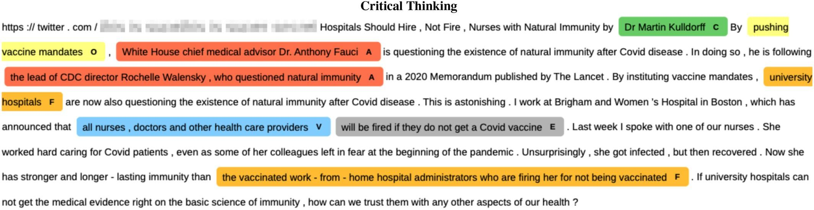
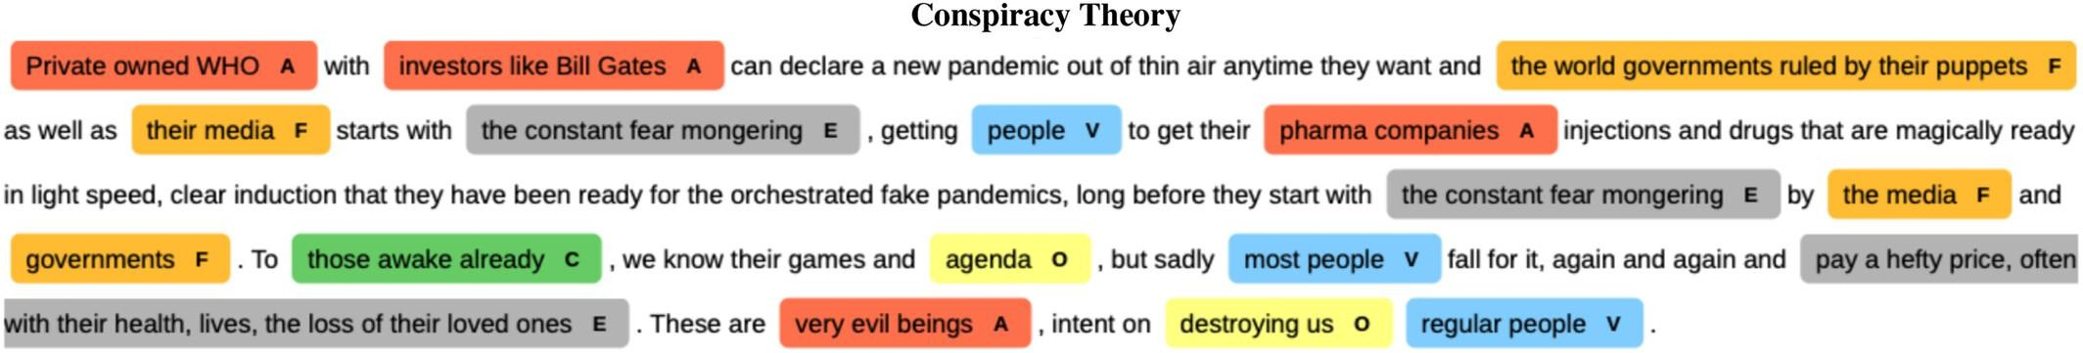
Annotation Examples
TASKS DESCRIPTION
What distinguishes conspiracy from critical narratives? A computational analysis of oppositional discourse - Korenčić - 2024 - Expert Systems - Wiley Online Library

Slide 7
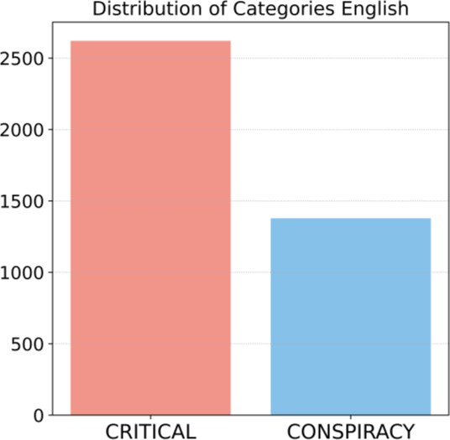
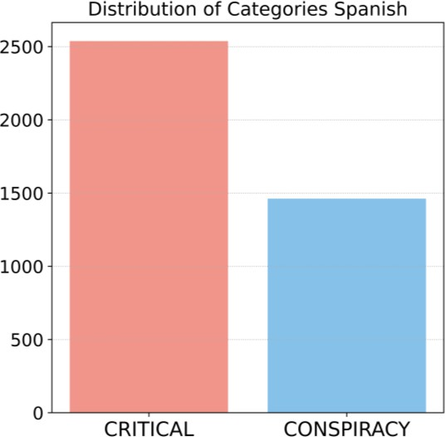
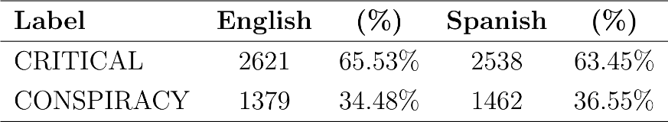
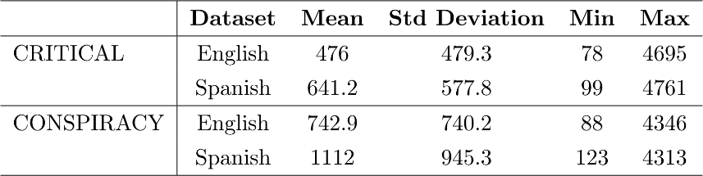
Task 1 – Dataset Description
DATASET DESCRIPTION

Slide 8
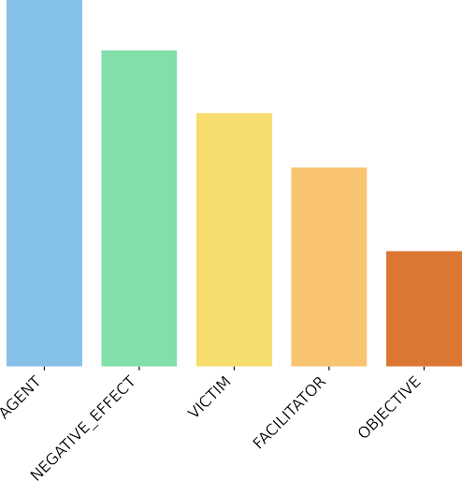






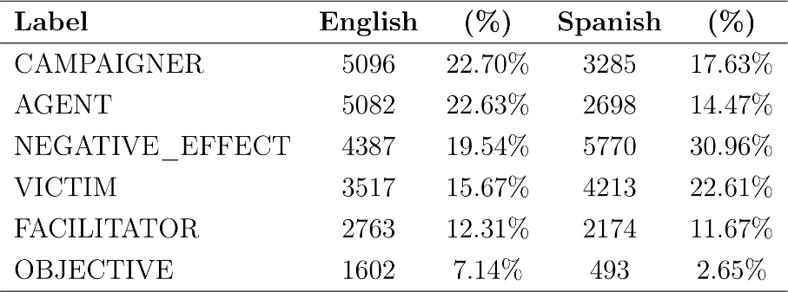
Task 2 – Dataset Description
DATASET DESCRIPTION

Slide 9
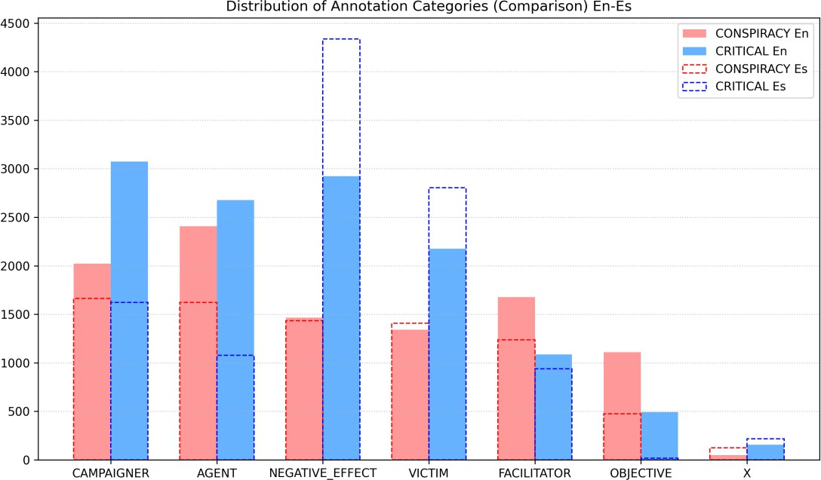
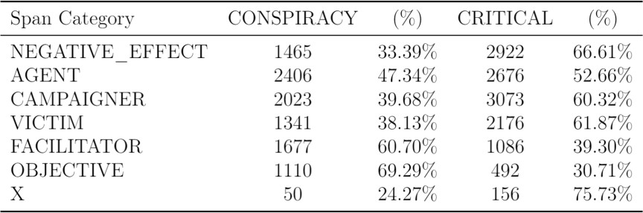
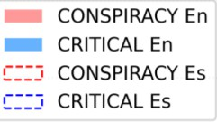
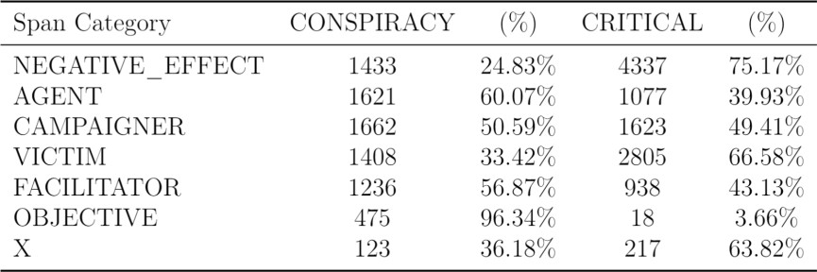
Distribution of Annotation Categories
DATASET DESCRIPTION
English Dataset
Spanish Dataset

Slide 10
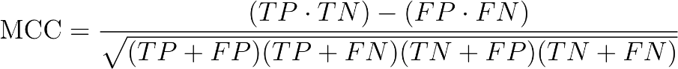
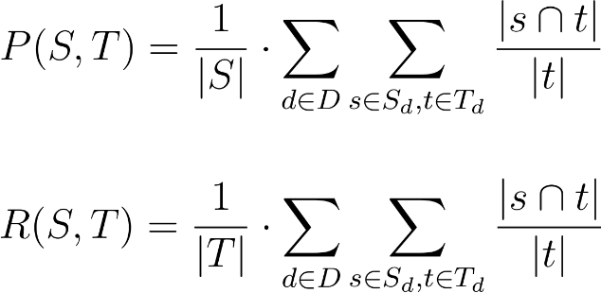
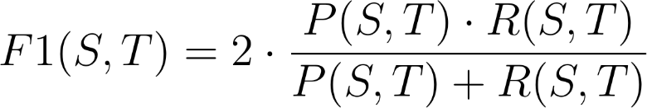
Evaluation Metrics
EVALUATION METRICS
Binary Classification
Matthews Correlation Coefficient
Span-level Detection
Span-F1 Metric
TP | FP
FN | TP
CRITICAL
Actual
CONSPIRACY
CRITICAL CONSPIRACY
Predicted

Slide 11
Experimental Framework
EXPERIMENTAL FRAMEWORK
Experiments were conducted on an NVIDIA GeForce GTX 1080
learning rate evaluation_strategy save_strategy num_train_epochs weight_decay load_best_model_at_end metric_for_best_model gradient_accumulation_steps per_device_train_batch_size per_device_eval_batch_size
linear_learning_rate_scheduler epoch
epoch 15
0.01
True f1
4
batch_size batch_size

Slide 12
Task 1 - Approach
TASK 1
Fine-tuning models with various hyperparameters
Stratified K-Fold cross validation
Data augmentation via translation-based techniques:
English: Translated Spanish dataset to English (Helsinki-NLP/opus-mt-es-en)
Spanish: Translated English dataset to Spanish
(Helsinki-NLP/opus-mt-en-es)
Run 1 : Predictions using the best model checkpoint
Run 2 : Predictions using Soft Voting Ensembling method

Slide 13
Task 1 - Approach
TASK 1
FOLD 1
-model checkpoint 1
-model checkpoint 2
.
.
-model checkpoint 15
FOLD 2
-model checkpoint 1
-model checkpoint 2
.
.
-model checkpoint 15
FOLD 3
-model checkpoint 1
-model checkpoint 2
.
.
-model checkpoint 15
x3
original train Dataset
+
translated train
Dataset
original train dataset
data loading tokenizer
model initialization data collator
best model checkpoint
Cross-validation loop
optimizer Trainer Evaluator
Ensemble models
best model checkpoint 1
test dataset
best model checkpoint 2
predictions
best model checkpoint 3

Slide 14
Task 1 – Data Augmentation
TASK 1
English → Spanish
Spanish → English
"2021 : They wanted to know your vaccination status and see your papers to be allowed to go to restaurants. 2023 : They don't want you to know the vaccination status of someone who died suddenly."
"No tengo idea, pero si ya se ha vacunado el 92%de los Españoles, mi intuición me dice que no hace falta la obligación."
Helsinki-NLP/opus-mt-es-en
Helsinki-NLP/opus-mt-en-es
"I have no idea, but if 92% of the Spaniards have already been vaccinated, my intuition tells me that the obligation is not necessary."
"2021 : Querían saber su estado de vacunación y ver sus papeles para que se les permita ir a los restaurantes. 2023 : No quieren que usted sepa el estado de vacunación de alguien que murió de repente."

Slide 15
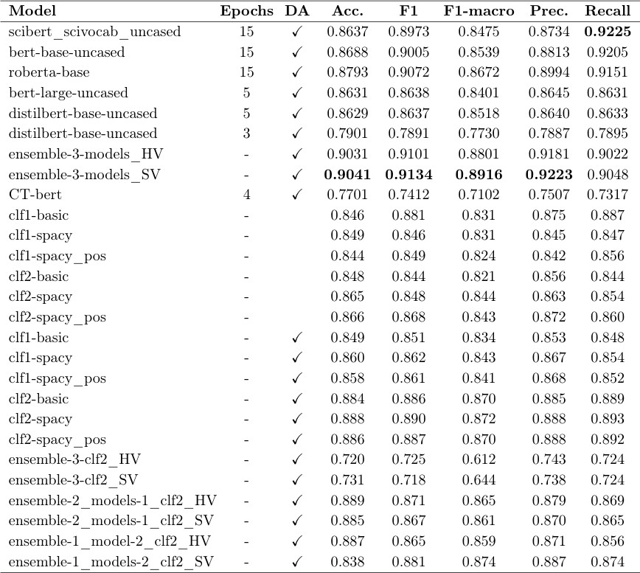
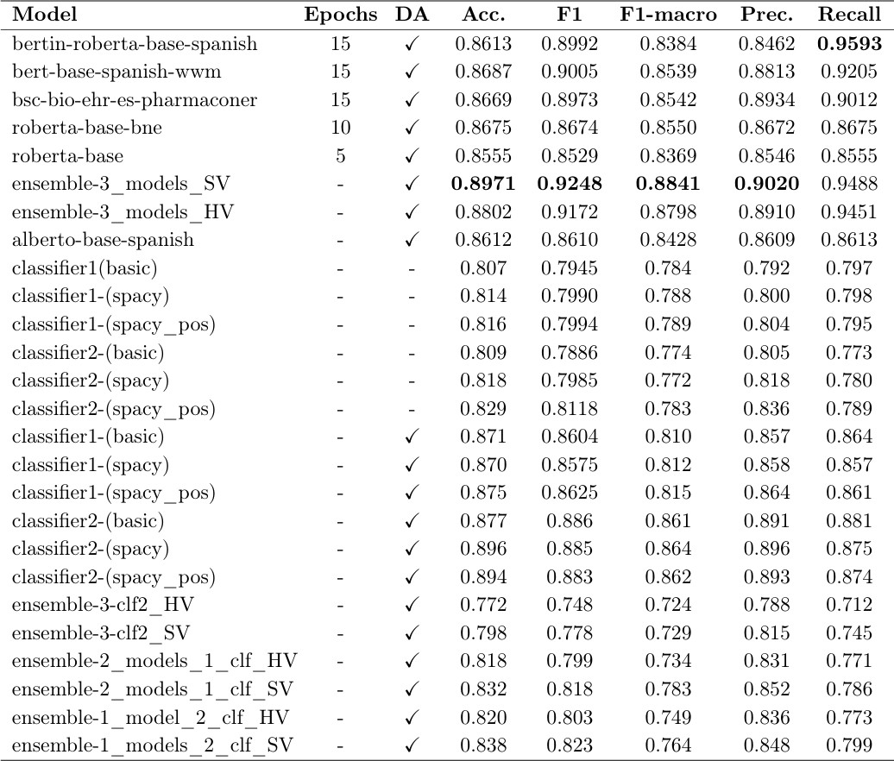
Task 1 – Experiments on the Train Dataset
TASK 1
English Spanish
* *
DA* = Data Augmented

Slide 16
Task 1 – Submitted Models
TASK 1
0: 0.6
1: 0.4
facebook/roberta-base
Model
used for
English:
0: 0.1
1: 0.9
0: 0.33
1: 0.67
google/bert-base-uncased
1
allenai/scibert_scivocab_unca
sed
0: 0.3
1: 0.7
CONSPIRACY : 0
CRITICAL : 1
dccuchile/bert-base-spanish- wwm-uncased
0: 0.6
1: 0.4
Model used for Spanish:
bertin-project/bertin-roberta- base-spanish
0: 0.1
1: 0.9
0: 0.33
1: 0.67
1
PlanTL-GOB-ES/bsc-bio-ehr- es-pharmaconer
0: 0.3
1: 0.7

Slide 17
Task 2 - Approach
TASK 2
We treated it as a token classification problem:
Fine-tuning transformer models with a token classification head
Sentence-level processing to avoid text truncation
Data augmentation via synonym replacement:
-English: static word embeddings (word2vec) and SpaCy (GoogleNews-vectors-negative300)
-Spanish: FastText and SpaCy
(FastText embeddings from the Spanish Unannotated Corpora)
Run 1 : Using the best model checkpoint
Run 2 : Additional training with the augmented dataset

Slide 18
Task 2 - Approach
TASK 2
FOLD 1
-model checkpoint 1
-model checkpoint 2
.
.
-model checkpoint 15
FOLD 2
-model checkpoint 1
-model checkpoint 2
.
.
-model checkpoint 15
FOLD 3
-model checkpoint 1
-model checkpoint 2
.
.
-model checkpoint 15
original train dataset
original train Dataset
+
synonym train Dataset
data loading
tokenizer
Data processing
Cross-validation loop
spacy model initialization data preprocessing
optimizer Trainer Evaluator
best model
checkpoint
test dataset
Train one epoch
augmented dataset
new best
model
no cross-validation
no evaluation dataset
predictions

Slide 19
Task 2 – Data Augmentation
TASK 2
English
I ’m deeply concerned that the push to vaccinate these children is nothing more than a dystopian experiment with unknown consequences.” — Rep. Louie Gohmert ( R - Texas) # TheDefender."
Spanish
El ex vicepresidente de Pfizer vuelve a advertir sobre las vacunas COVID y el ' riesgo severo ' de infertilidad para las mujeres.
word2vec and SpaCy (GoogleNews-vectors-negative300)
FastText embeddings from the Spanish Unannotated Corpora
I ’m profoundly worried that the drive to immunize these kids is nothing less than a nightmarish experiment with unforeseen repercussion . ” — Rep. Louie Gohmert ( R - Texas ) # TheDefender."
El convicto presidente de Pfizer regresa a alertar sobre las vacunas COVID y el ‘ peligro alto ' de endometriosis para las niñas.

Slide 20
Task 2 – Data Augmentation
TASK 2
"text": “I’m deeply concerned that the push to vaccinate these children is nothing more than a dystopian experiment with unknown consequences“, - Rep. Louie Gohmert ( R – Texas ) # TheDefender.”
“annotations":
{
"span_text": "I’m deeply concerned that the push to vaccinate these children is nothing more than a dystopian experiment with unknown consequences",
"category": "NEGATIVE_EFFECT",
"start_char": 0,
"end_char": 145,
"start_spacy_token": 0,
"end_spacy_token": 21
{
"span_text": "these children", "category": "VICTIM", "start_char": 48,
"end_char": 62,
"start_spacy_token": 9,
"end_spacy_token": 11
},
{
"span_text": "to vaccinate these children",
"category": "OBJECTIVE", "start_char": 35,
"end_char": 62,
"start_spacy_token": 7,
"end_spacy_token": 11
},
},
word2vec and SpaCy (GoogleNews-vectors-negative300)

Slide 21
Task 2 – Data Augmentation
TASK 2
"text": “I’m profoundly worried that the drive to immunize these kids is nothing less than a nightmarish experiment with unforeseen repercussions“, - Rep. Louie Gohmert ( R – Texas ) # TheDefender.”
“annotations":
{
"span_text": "I’m profoundly worried that the drive to immunize these kids is
nothing less than a nightmarish experiment with unforeseen repercussions ",
"category": "NEGATIVE_EFFECT",
"start_char": 0,
"end_char": 144,
"start_spacy_token": 0,
"end_spacy_token": 21
{
"span_text": "these kids", "category": "VICTIM", "start_char": 50,
"end_char": 60,
"start_spacy_token": 9,
"end_spacy_token": 11
},
{
"span_text": "to immunize these kids",
"category": "OBJECTIVE", "start_char": 41,
"end_char": 60,
"start_spacy_token": 7,
"end_spacy_token": 11
},
},

Slide 22
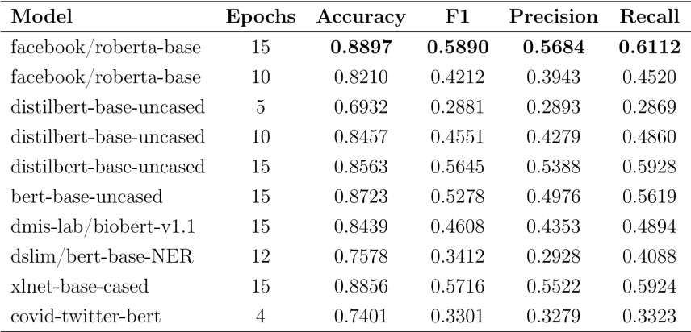
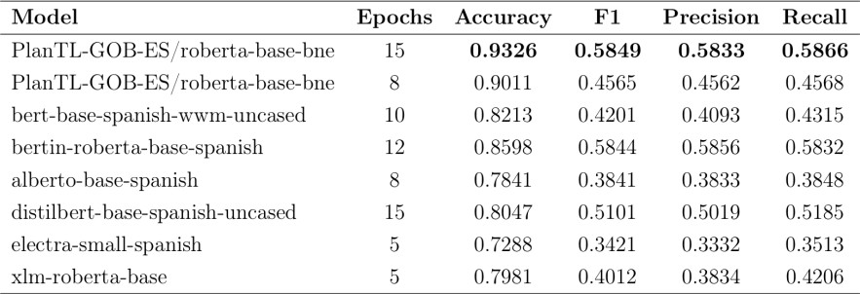
Task 2 - Experiments on Train Dataset
TASK 2
Submitted model
Model used for English:
Submitted model
Model used for Spanish:

Slide 23
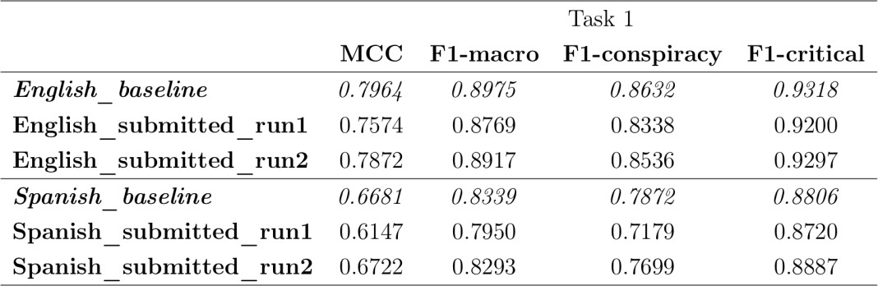
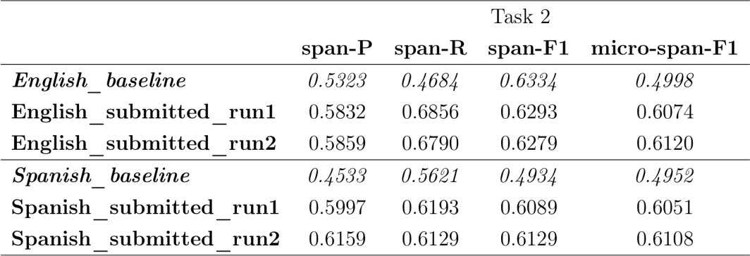
Evaluation Results
EVALUATION RESULTS
Binary Classification Task
Span-level Detection Task

Slide 24
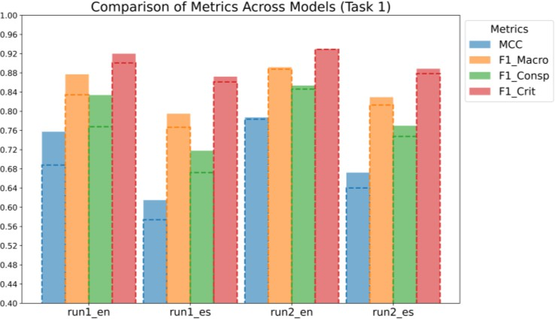
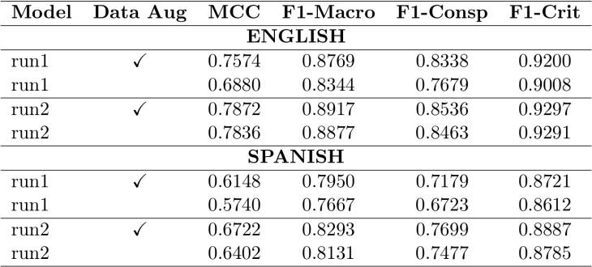
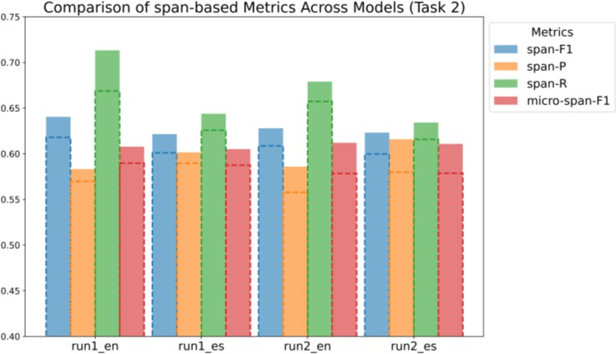
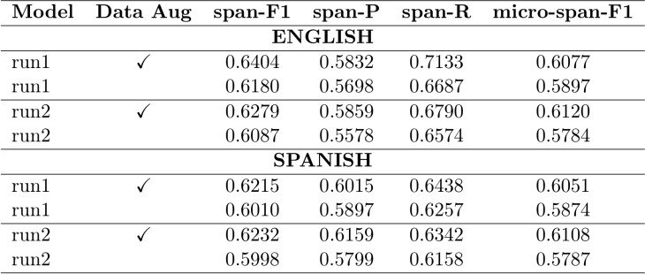
Experiments with and without data Augmentation
TASK 1 & 2
Task 1
Task 2

Slide 25
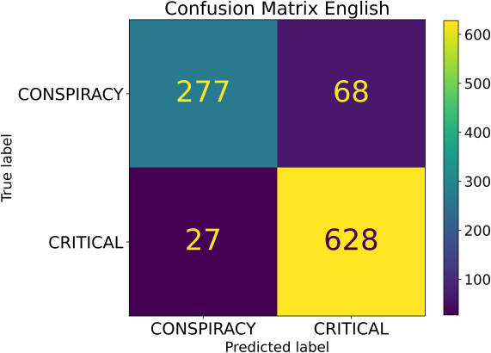
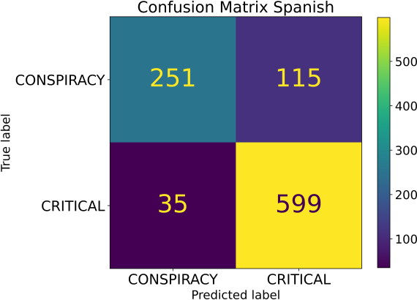
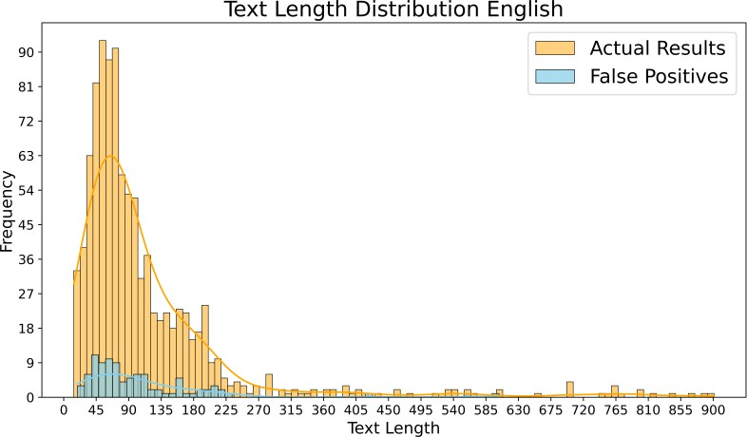
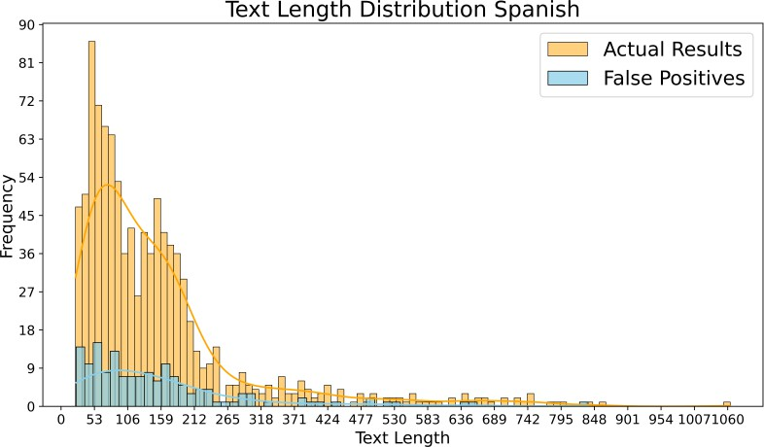
Error Analysis Task 1
ERROR ANALYSIS

Slide 26
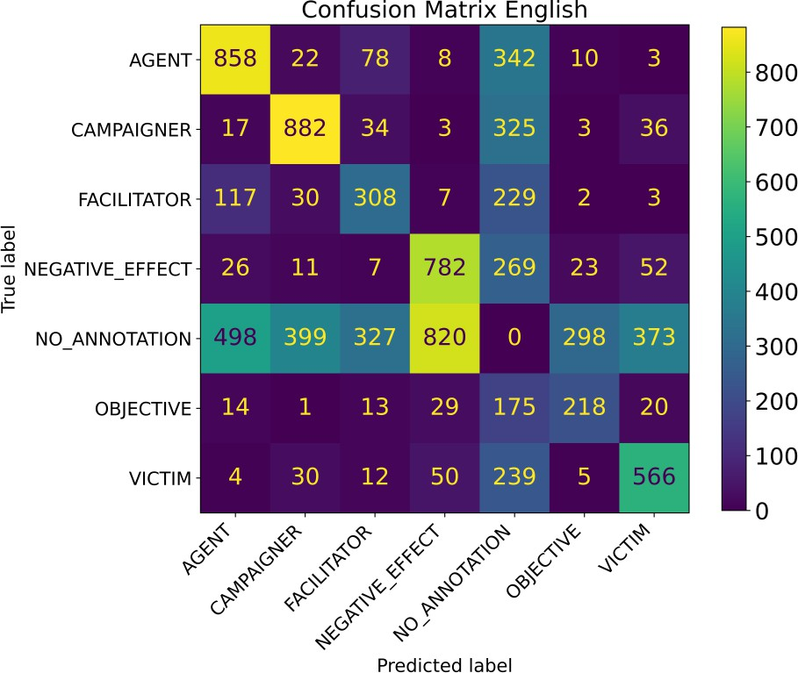
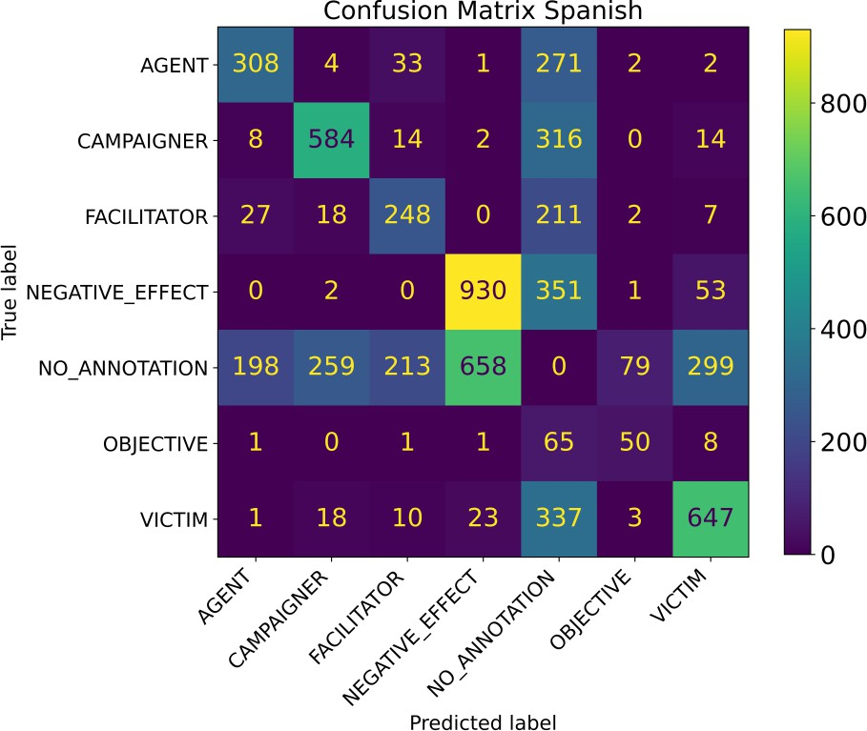
Error Analysis Task 2
ERROR ANALYSIS

Slide 27
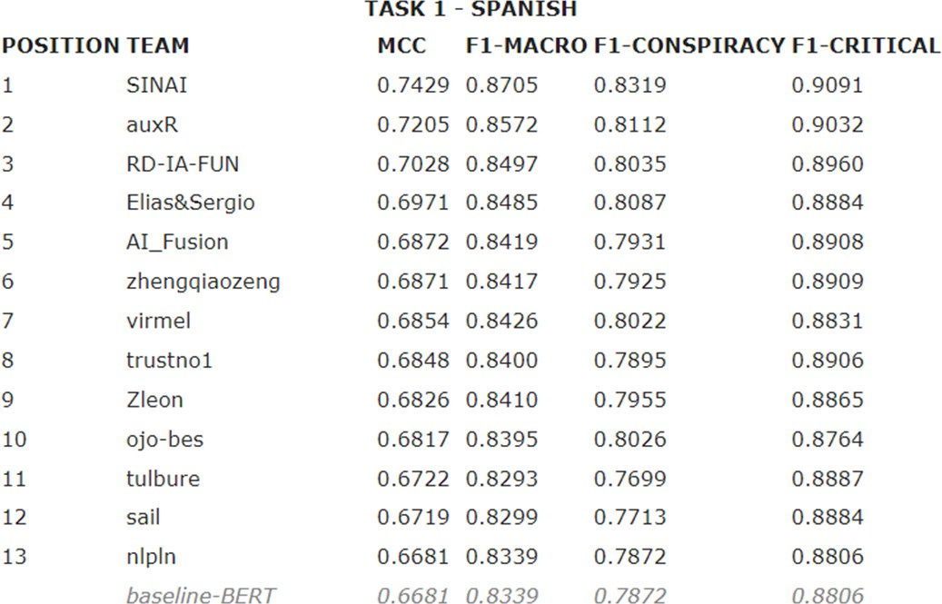
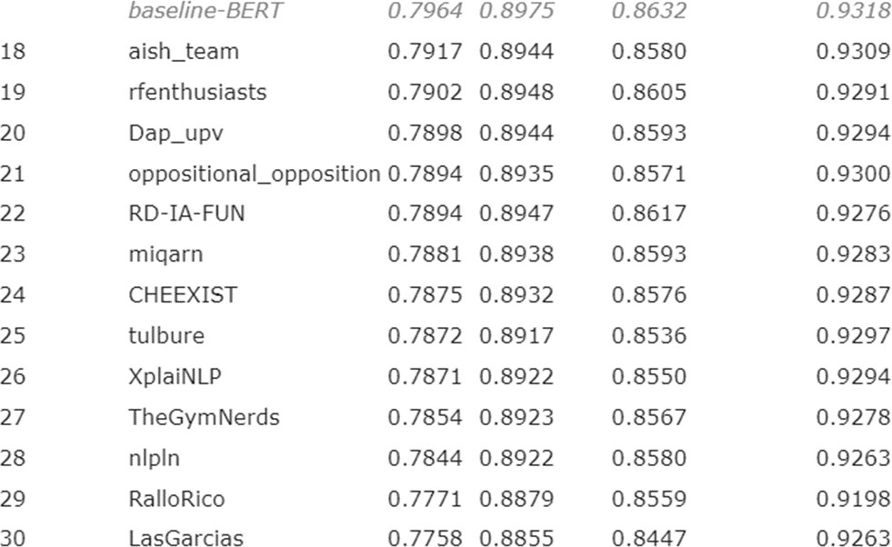
Official Ranking Task 1
OFFICIAL RANKING
~1%
~0.4%
Total Participating Teams: 82

Slide 28
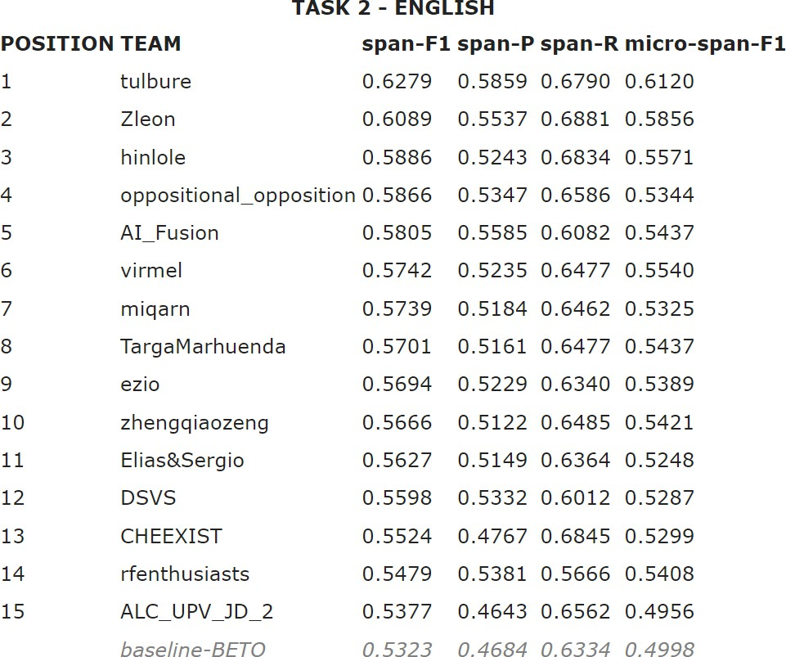
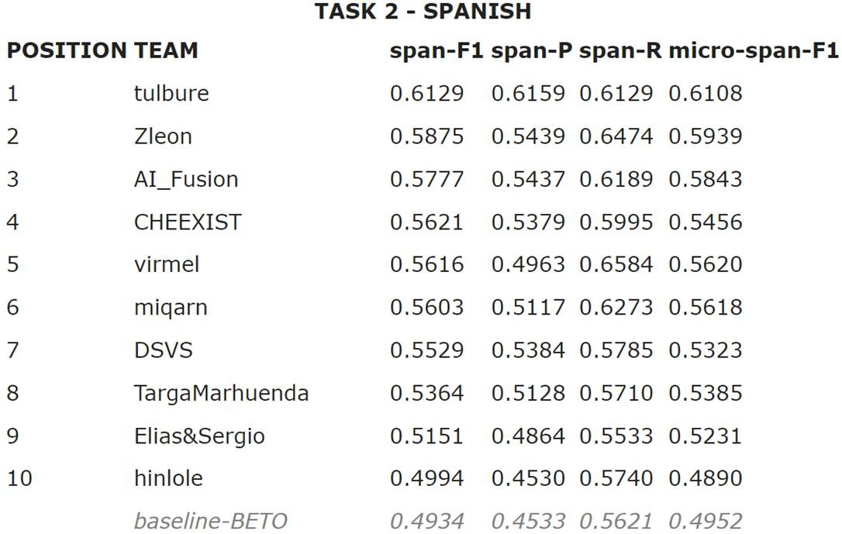
Official Ranking Task 2
OFFICIAL RANKING
~11%
~12%

Slide 29
Further Experiments with Multilingual Transformers
Models and Large Language Models
FURTHER EXPERIMENTS
Methods used:
Multilingual Transformer Models :
Leverage the 2 datasets simultaneously
Large Languale Models :
Zero shot learning (text-generation mode)
Few shot learning (text-generation mode)
Zero shot learning (text-classification mode)
Few shot learning (text-classification mode)
Fine-Tuning LLMs with QLoRA
Fine-Tuning LLMs with Zero-shot prompting
Fine-Tuning LLMs with Few-shot prompting

Slide 30
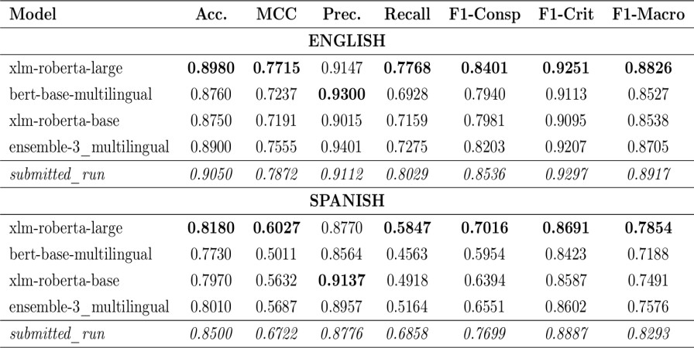

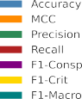
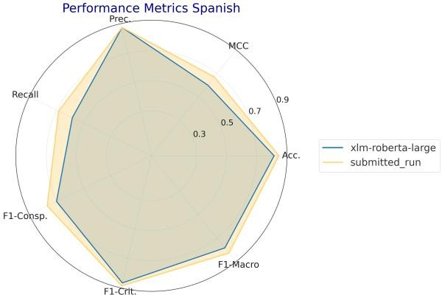
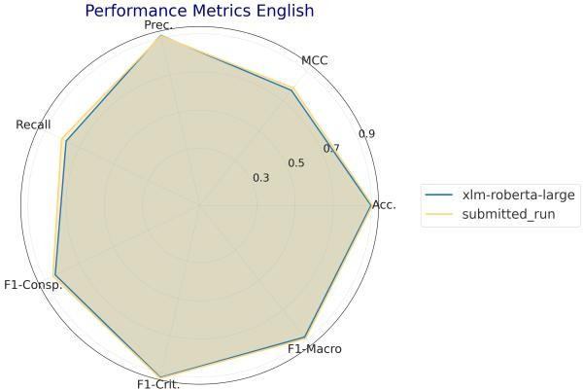
Multilingual Transformer Models Task 1
TASK 1

Slide 31
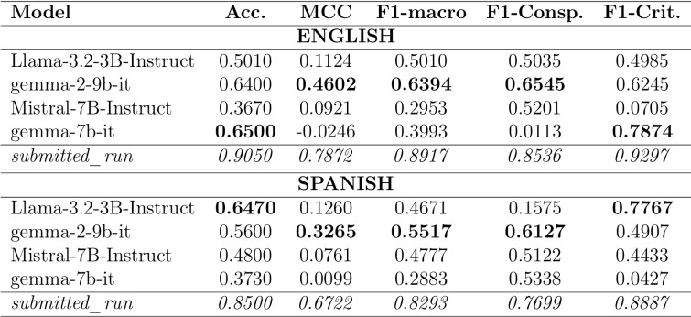
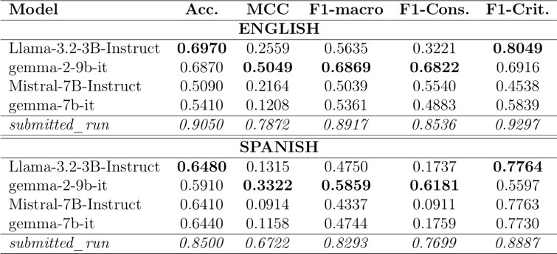
Zero and Few shot Learning Task 1
TASK 1
– Text Generation Mode -
Zero-shot Learning
prompt = “<s>[INST] «SYS»
You are an expert critical thinker specialized in analyzing public health narratives, particularly regarding the COVID-19 pandemic.
You are tasked with classifying a text into one of these two categories:
CRITICAL THINKING: Texts that question major public health decisions but do not
suggest that secret, powerful, or malevolent groups are behind these decisions.
CONSPIRACY THEORIES: Texts that imply public health decisions, especially those regarding the COVID-19 pandemic, are part of a plot orchestrated by secret, powerful, and malevolent groups.
Here below there are some examples:
– – – Start of the Examples – – –
<EXAMPLES>
– – – End of the Examples – – –
Now, say if the following text is ’CRITICAL’ or ’CONSPIRACY’:
«/SYS»
{user_text}
[/INST]</s>”
Few-shot Learning

Slide 32
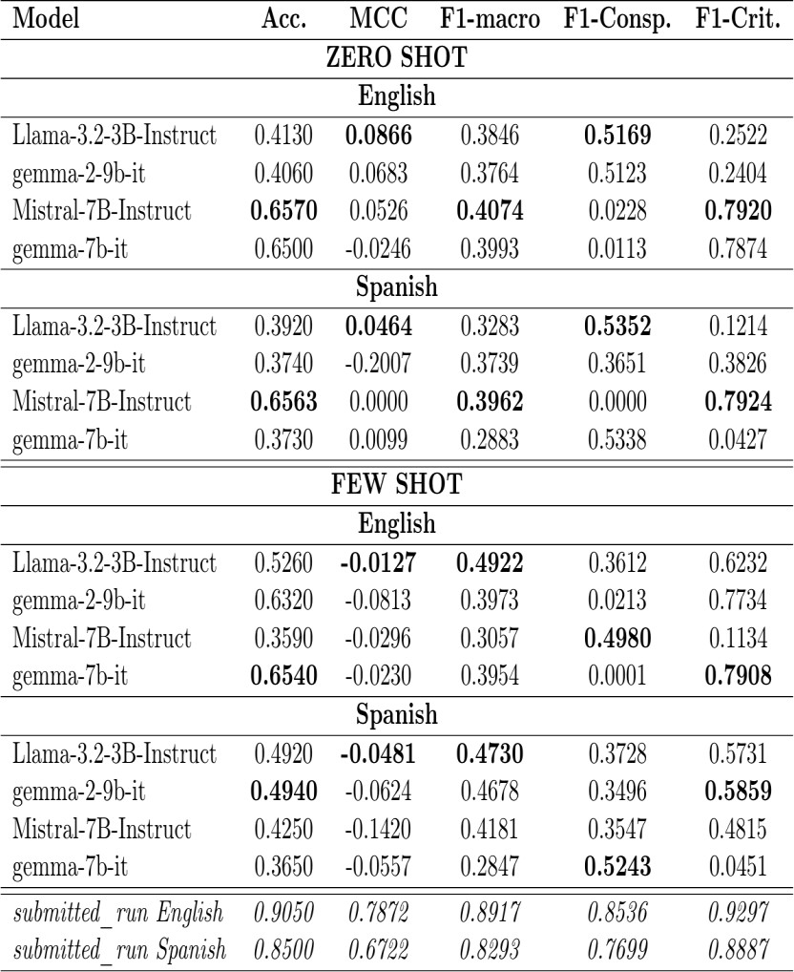
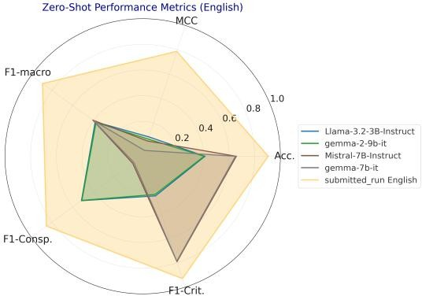
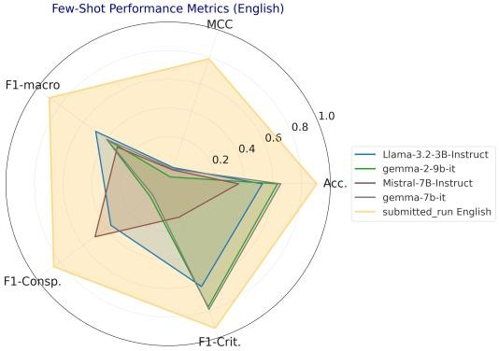
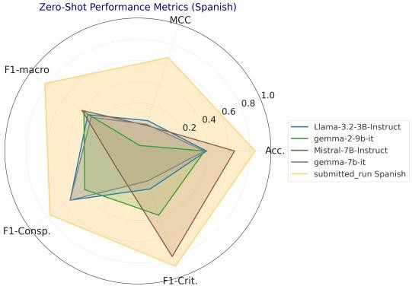
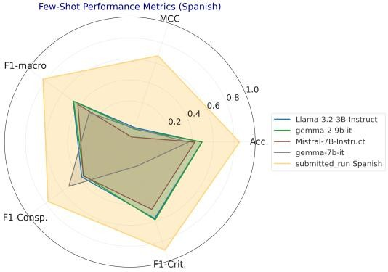
Zero and Few shot Learning Task 1
TASK 1
– Text Classification Mode -

Slide 33
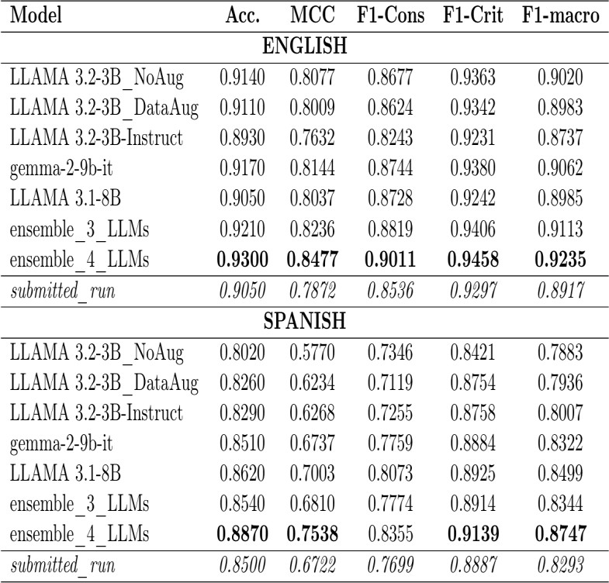


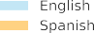

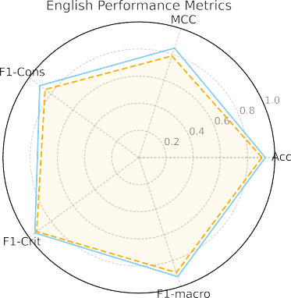
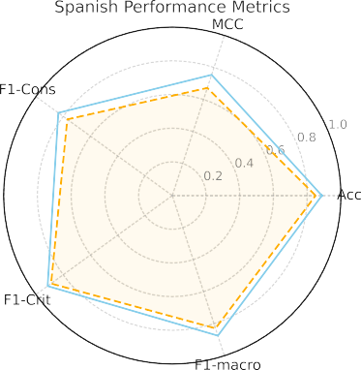






Fine-Tuning LLMs Task 1
TASK 1

Slide 34




Fine-Tuning LLMs with Zero and Few shot Learning Task 1
TASK 1
First Method [preproc] : embed prompt during preprocessing ([prompt] + [text])
Second Method [train_ctx] : dynamically integrate prompts during training
prompt = “
<s>[INST] You are tasked with classifying whether a given text is a CRITICAL statement questioning public health decisions, or a CONSPIRACY narrative alleging a secret plot related to the pandemic.
Here below there are some examples: – – – Start of the Examples – – –
- Start Examples of CRITICAL texts - -
<EXAMPLES_CRITICAL>
- End Examples of CRITICAL texts - -
- Start Examples of CONSPIRACY texts - -
<EXAMPLES_CONSPIRACY>
- End Examples of CONSPIRACY texts - - – – – End of the Examples – – –
</s>[/INST] ”
Fine-tuning with ZSL
Fine-tuning with FSL

Slide 35







Multilingual Transformer Models Task 2
TASK 2

Slide 36



Zero and Few shot Learning – Task 2
TASK 2
First prompt:
prompt = “<s>[INST]
You are an expert in detecting elements of the texts. Since conspiracy narratives are a special type of causal explanation, your task consists in the recognition of text spans corresponding to the key elements of a text. Step 1: Identify all of the negative effects mentioned in the text and relate them to the oppositional narrative. A negative effect is a harmful consequence or negative impact related to conspiracy theories or critical aspects. Put these negative effects in the same form that they appear in the text in different lines with the keyword “NEGATIVE_EFFECT”.
…
[/INST]</s> ”
Second prompt:
prompt = “<s>[INST]
You are an expert in detecting elements of the texts. Since conspiracy narratives are a special type of causal explanation, your task consists in the recognition of text spans corresponding to the key elements of a text.
- Identify all the negative effects mentioned in the text and relate them to the oppositional narrative. They are the negative consequences suffered by the victims as a result of the actions and decisions of those in power and/or their collaborators. Put these negative effects in the same form that they appear in the text in different lines with the keyword “NEGATIVE_EFFECT”.
…
Provide an output like this: "annotations": [{ "span_text":
"category": "start_char": "end_char": }] [/INST]</s> ”

Slide 37


Conclusions
CONCLUSIONS
TASK 1 – BINARY CLASSIFICATION
Best Performances
Ensemble of fine-tuned LLMS
Fine-tuning LLMs without ZSL or FSL
Fine-tuning LLMs with FSL prompt-context Fine-tuning LLMs with FSL prompt-inside-text Fine-tuning LLMs with ZSL prompt-context
Fine-tuning LLMs with ZSL prompt-inside-text Fine-tuning LLMs with FSL prompt-context Fine-tuning LLMs with FSL prompt-inside-text FSL LLMs
ZSL LLMs
TASK 2 – SPAN-LEVEL CLASSIFICATION
Best Performances
Multilingual models
Monolingual models
Few shot learning LLMs
Zero shot learning LLMs

Slide 38

Contacts:
angelomaximilian.tulbure@mail.polimi.it
Thanks for your attention!
angelotulbure29@outlook.it
A N G E L O M A X I M I L I A N T U L B U R E

